Slide 1
Lecture No. 15
Combinational Functional Devices
Notes:
1

Slide 2
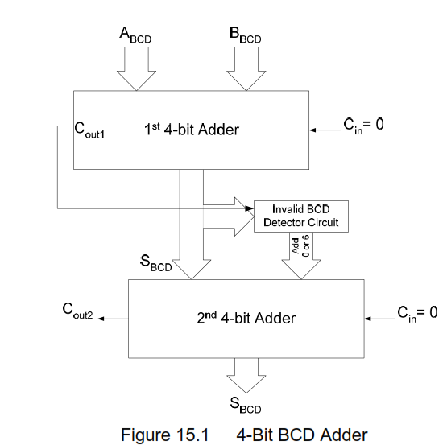
BCD Adder
Notes:
2
8 minutes
Total 13 minutes

Slide 3
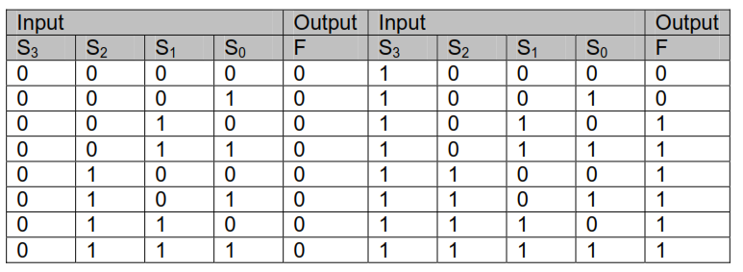
BCD Adder
Function table of invalid BCD Number Detector
Notes:
3

Slide 4
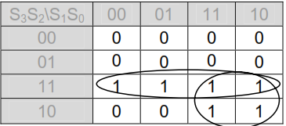
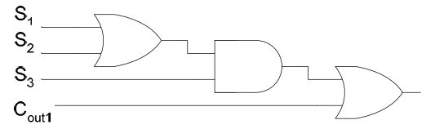
BCD Adder
Mapping Invalid BCD Number detector function
Invalid BCD Detector Circuit
Notes:
4
8 minutes
Total 13 minutes

Slide 5
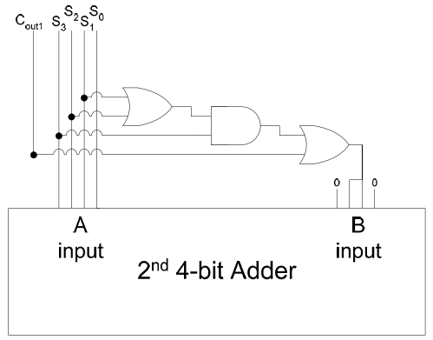
BCD Adder
Using second Adder to Add 6 or 0
Notes:
5
8 minutes
Total 13 minutes

Slide 6
BCD Adder
Notes:
6
8 minutes
Total 13 minutes

Slide 7
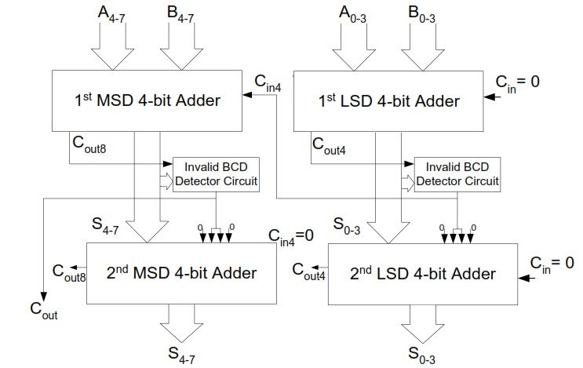
BCD Adder
2-digit BCD Adder
Notes:
7
8 minutes
Total 13 minutes

Slide 8
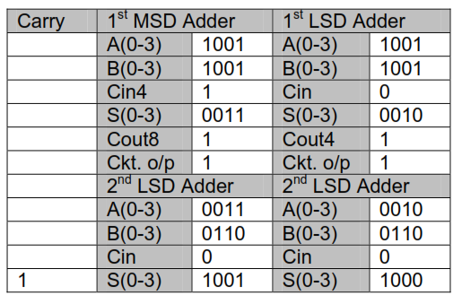
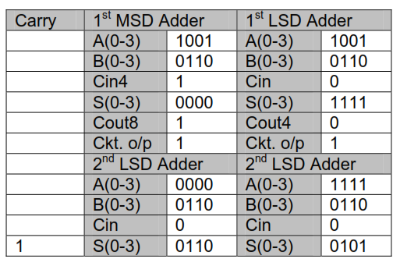
BCD Adder(Adding BCD Numbers)
Adding BCD Number
99 and 99
Adding BCD Number
99 and 66
Notes:
8
8 minutes
Total 13 minutes

